Slide 1
Mock Up, Test, and Refine: An Approach to Usability Testing
Mark Eaton and Carlos Arguelles

Slide 2
BACKGROUND
How to modify the library’s webpage according to users needs?
What type of information is needed to support updates?
Why this is not a systematic effort?
Conclusions:
Librarians have to step up to the challenge
Funding is needed

Slide 3
Definition
Usability Test is a way to evaluate a service with your target-market customers. Focusing on user experience (UX) testing: observing, recording, measuring library users’ (faculty and students) interactions with the library webpage.
Usability testing involves actual target users and matches real-world experiences (Prototypes). The use on an incentive to recruit participants is necessary.

Slide 4
Process
Requested a PSC-CUNY Grant and it was approved on September 2016.
Redistributed the funds according to a plan.
Training course for investigators involved in Social/Behavioral Research with human subjects
Summited to the University Integrated Institutional Review Board an application and was approved during Fall/2016. Two reasons:
To be able to work with Faculty and students
To be able to publish our results

Slide 5
Process (cont.)
It is an iterative approach in which the prototypes are redesigned constantly.
It was decided that part of this project was also to move all our webpages to CMS-Libguides
Establishing the different recruitment approaches.

Slide 6
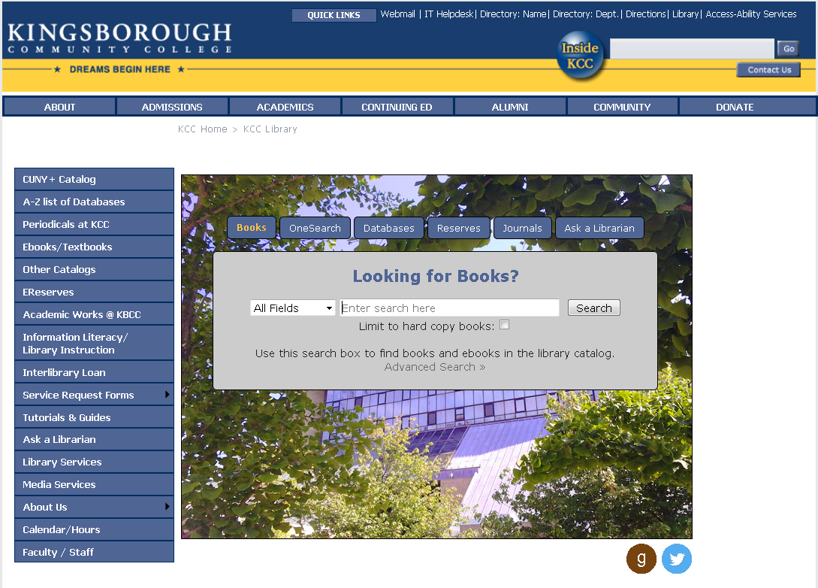

Slide 7
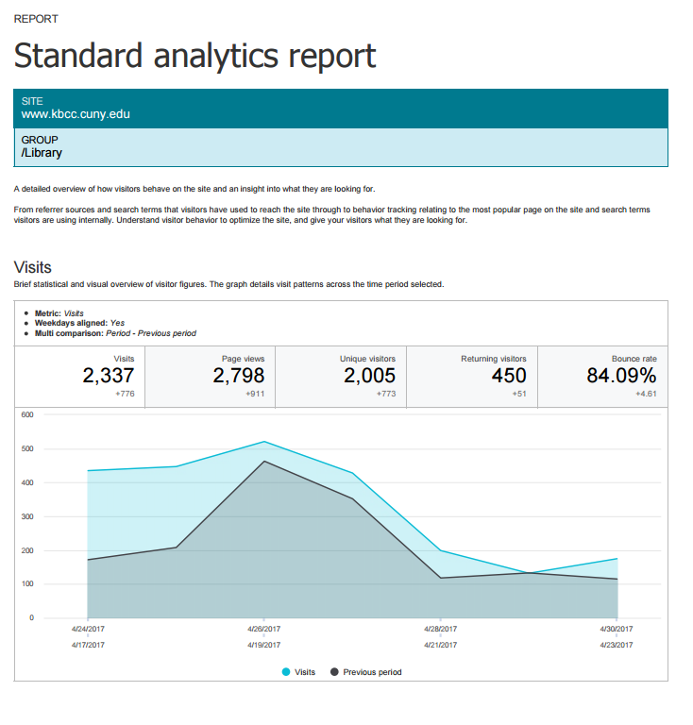

Slide 8


[ … , … ]

Slide 9
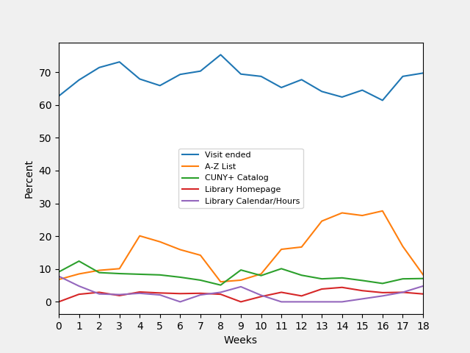

Slide 10

LibGuides CMS
Pros
Groups
Group-level JavaScript and CSS
Ease of building prototypes
Cons
After a while, all LibGuides start to look the same

Slide 11


Slide 12
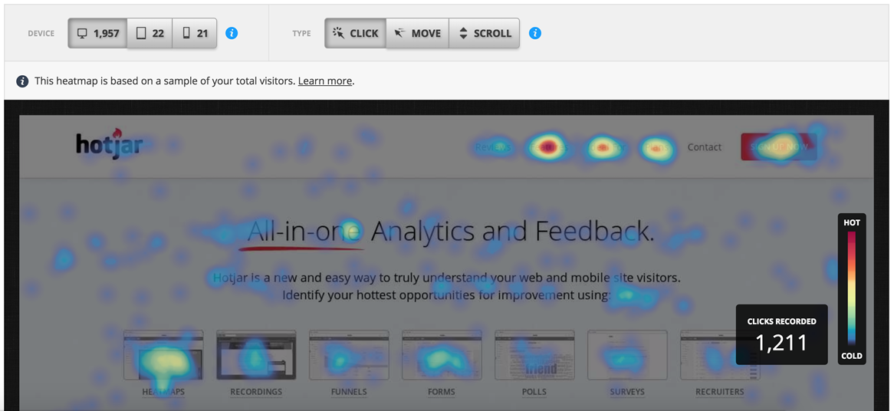

Slide 13
http://kbcc.cuny.libguides.com/prototype1?cohort=2
http://kbcc.cuny.libguides.com/prototype1?cohort=3
http://kbcc.cuny.libguides.com/prototype1?cohort=4

Slide 14
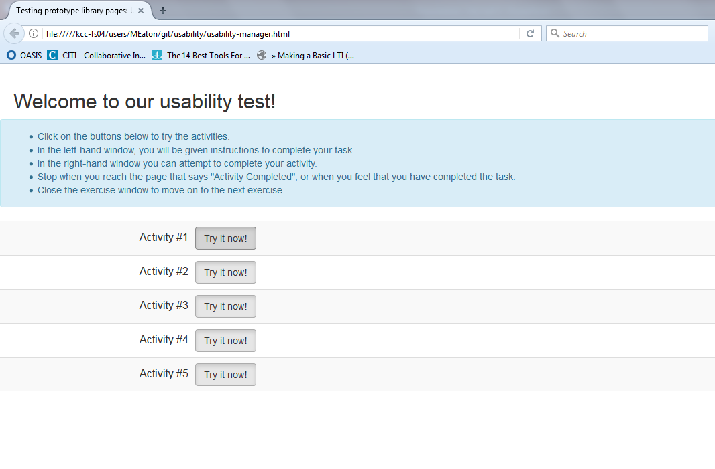

Slide 15
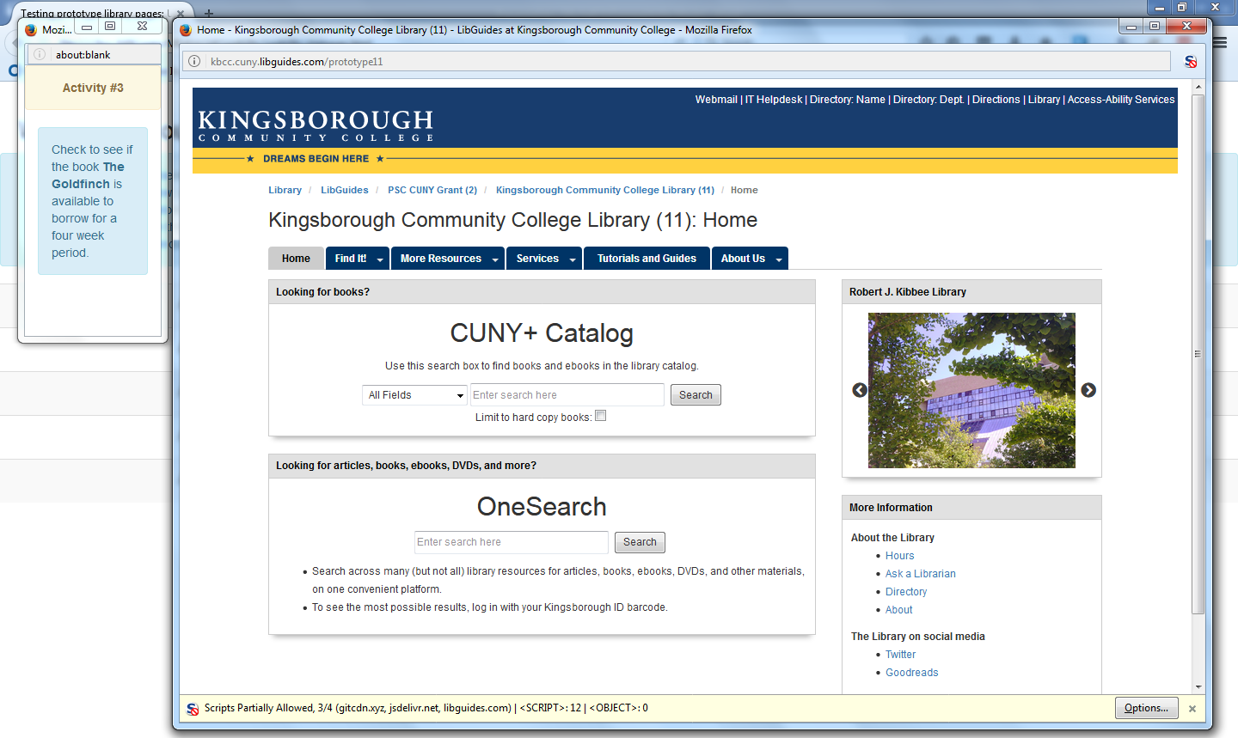

Slide 16
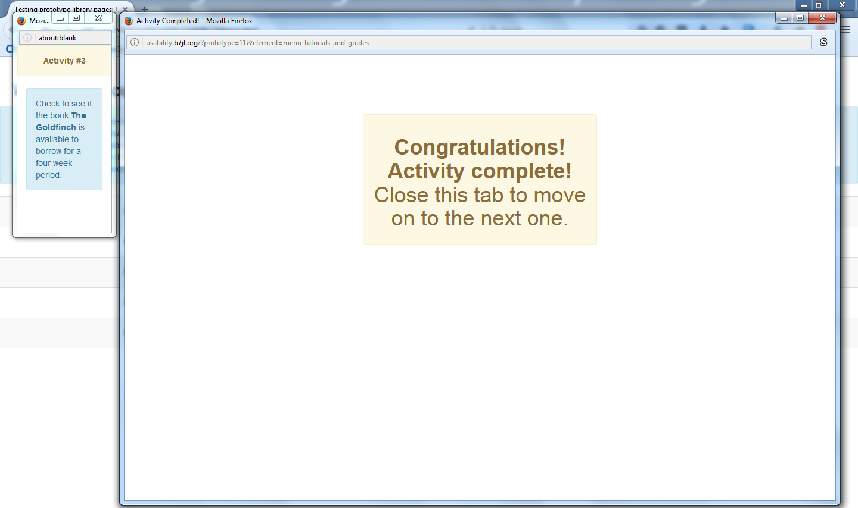

Slide 17


Slide 19
What we learned
Test more rigorously
Keep it simple
Don’t rely on others’ code

Slide 21
How will we track the data now?

Slide 23
http://usability.b7jl.org/?prototype=9&element=menu_periodicals
http://usability.b7jl.org/?prototype=10&element=widget_catalog
http://usability.b7jl.org/?prototype=12&element=box_calendar_hours

Slide 24


Slide 25


Data quality
Reliability
Hotjar visuals

Slide 26
github.com/MarkEEaton/usability-python
github.com/MarkEEaton/usability-testing-interface

Slide 27
Conclusions
Usability testing should be an institutionalize and an ongoing process.
Trouble finding tools for UX that meet our needs
Difficulty communicating with IT Department and selling the idea.
Time consuming process.

Slide 28
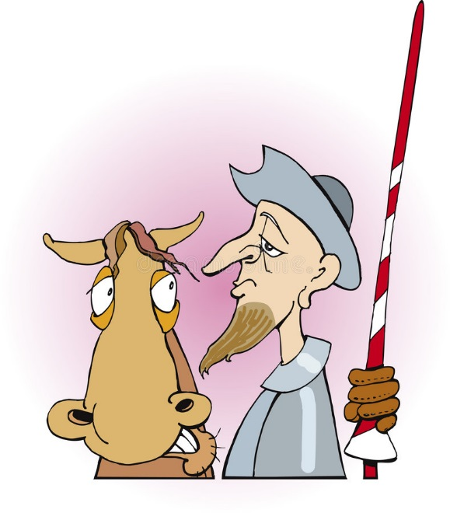
This has been a
Quixotic experience

Slide 29
THANK YOU
Mark Eaton
Assistant Professor – Reader Services Librarian
Mark.Eaton@kbcc.cuny.edu
Carlos Arguelles
Associate Professor – Reader Services Librarian
Carlos.Arguelles@kbcc.cuny.edu

